Slide 1
Docker

Slide 2
What is Docker?
Docker is a set of platforms as a service (PaaS) products.
Docker is an open-source containerization platform by which you can pack your application and all its dependencies into a standardized unit called a container.

Slide 3
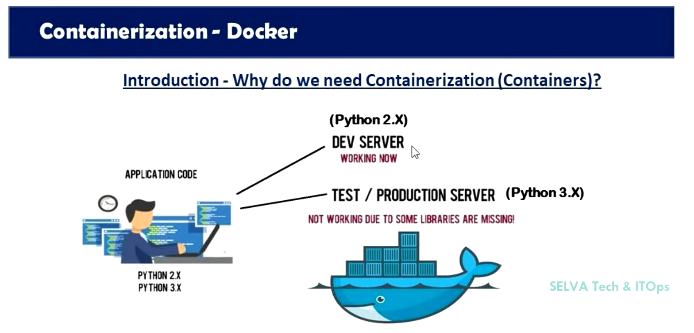

Slide 4
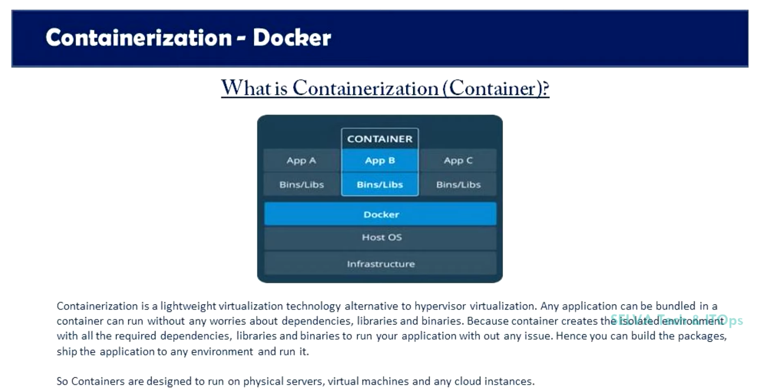

Slide 5
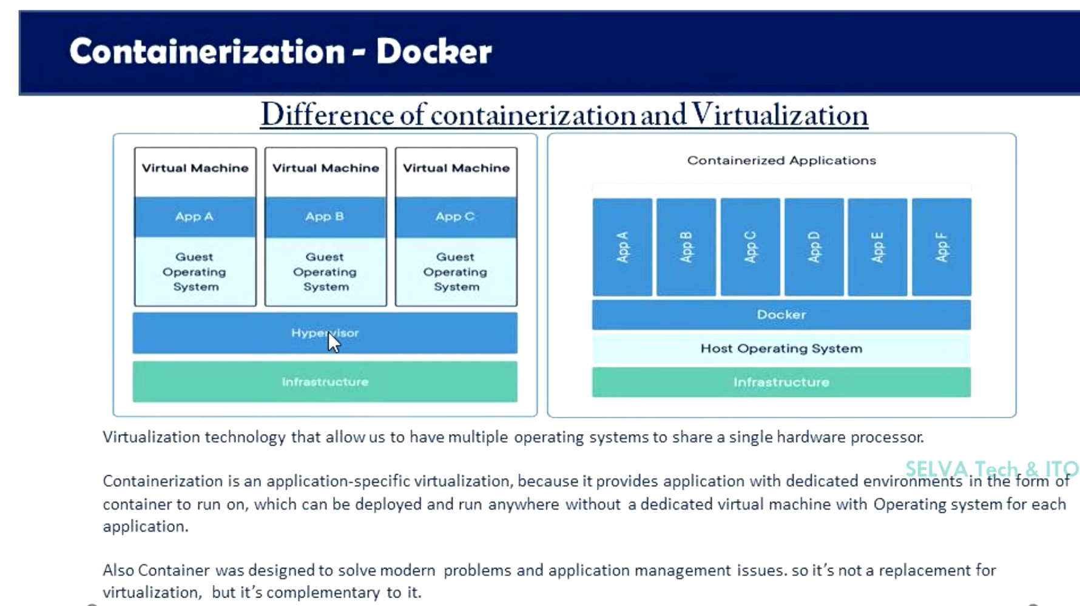

Slide 6
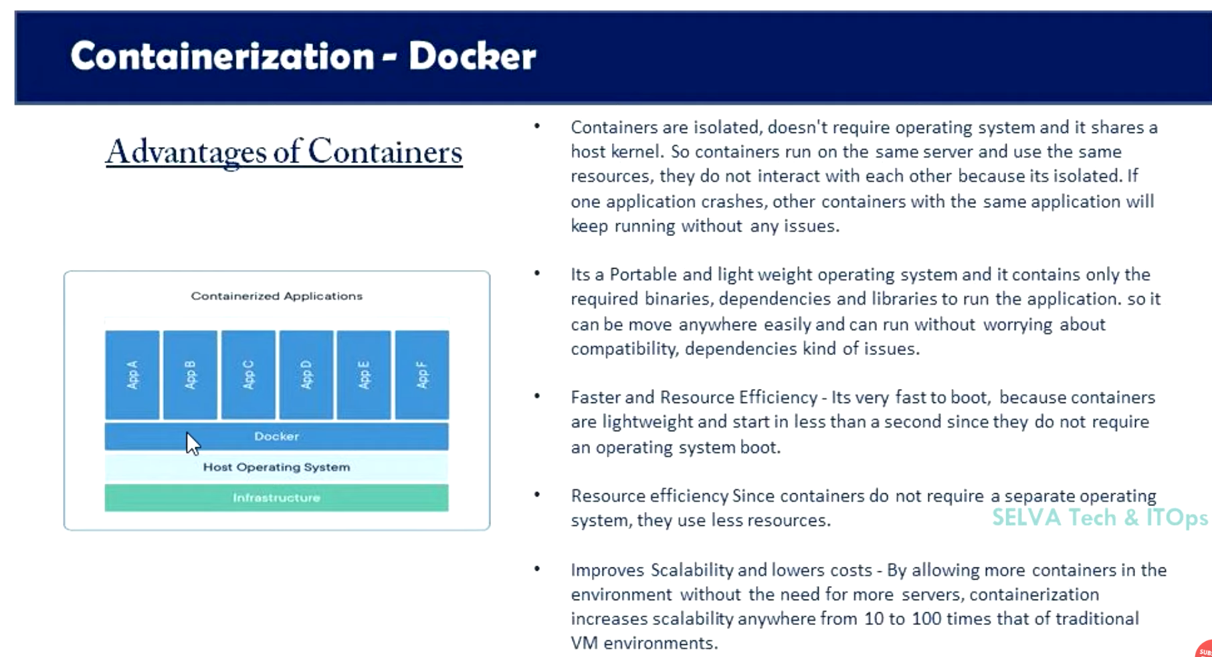

Slide 7
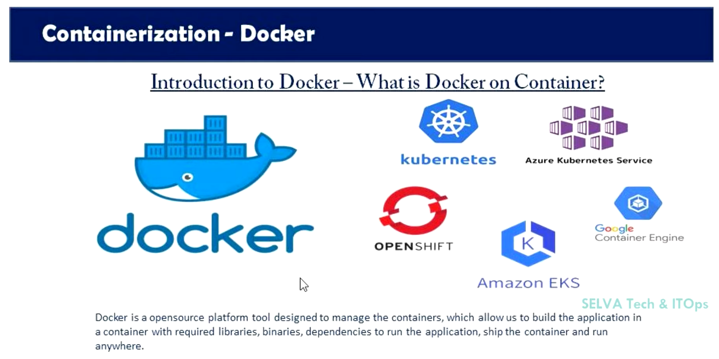

Slide 8
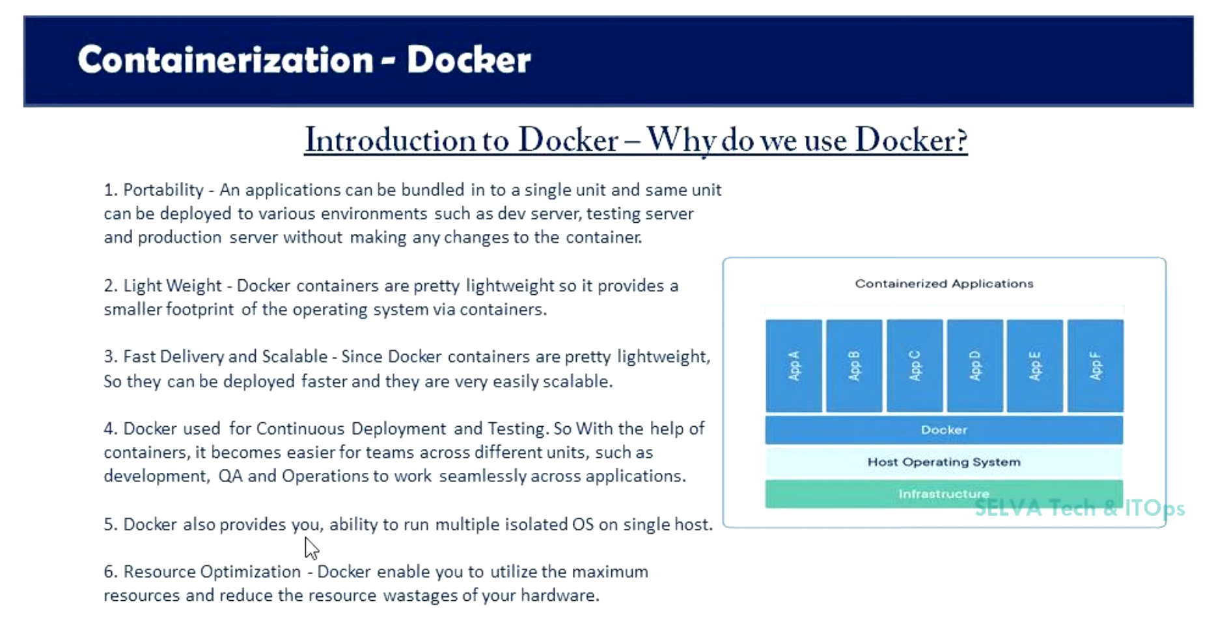

Slide 9
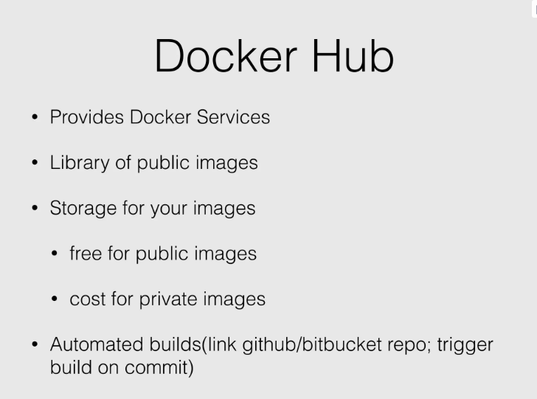

Slide 10
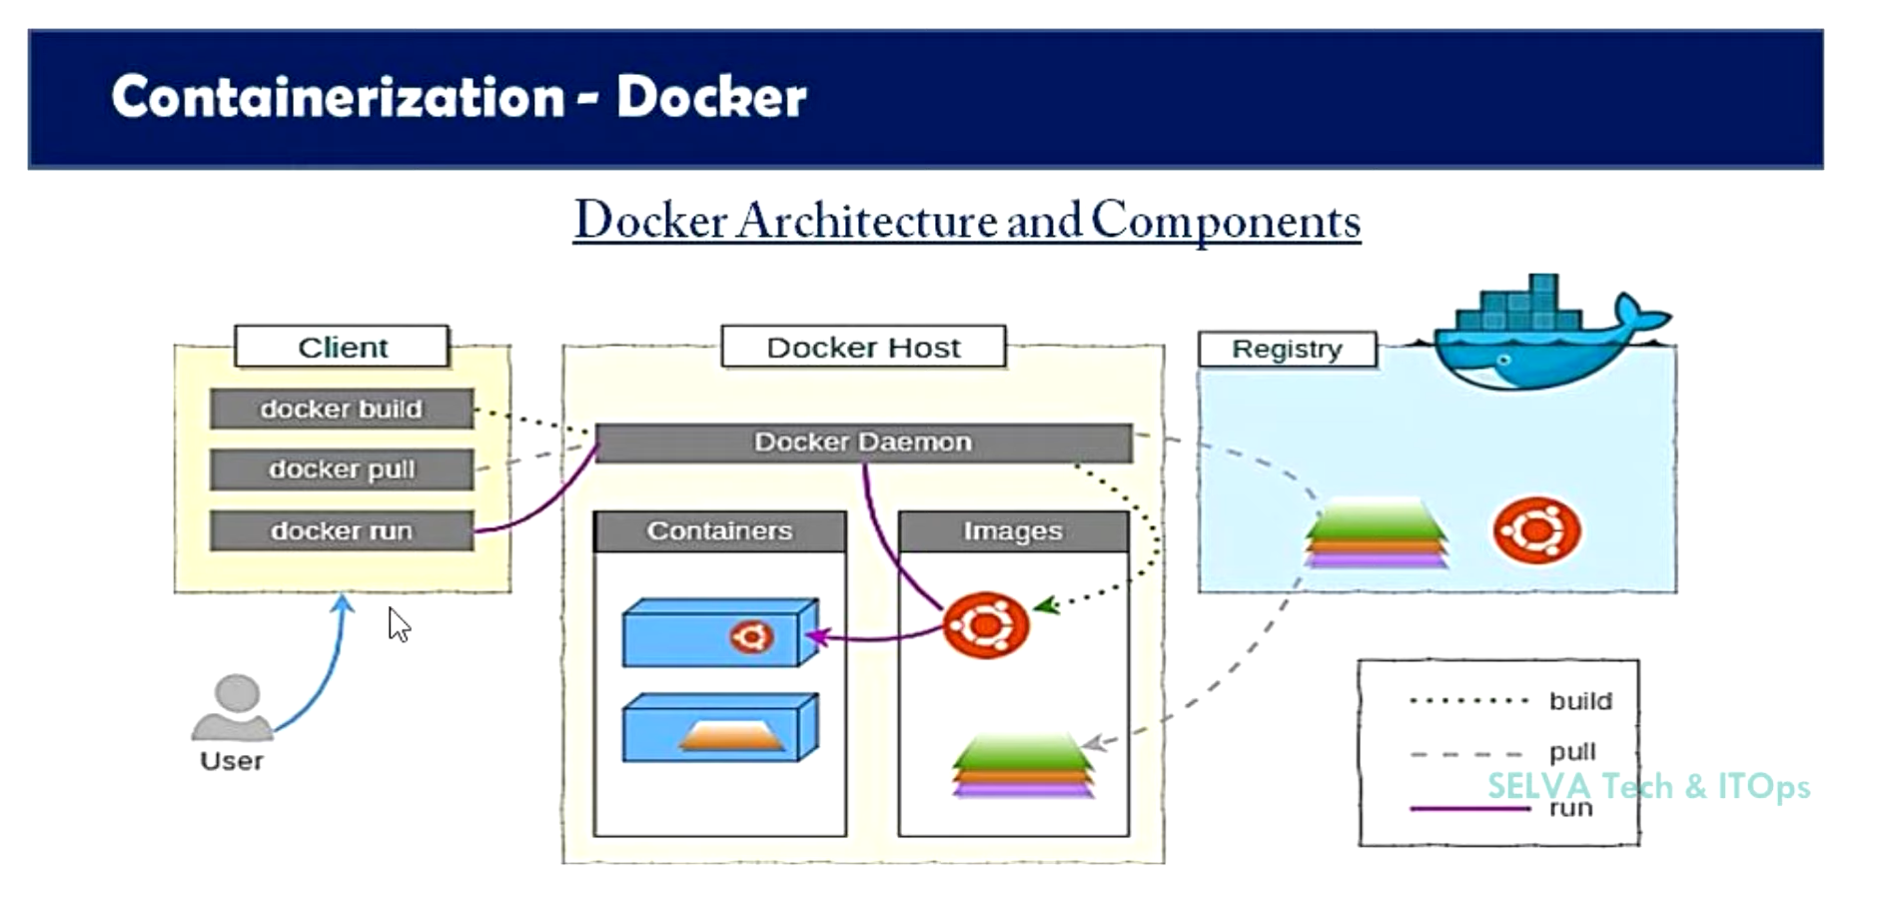

Slide 11
Docker Architecture
Docker makes use of a client-server architecture.
The Docker client talks with the docker daemon which helps in building, running, and distributing the docker containers.
The Docker client runs with the daemon on the same system or we can connect the Docker client with the Docker daemon remotely.
With the help of REST API over a UNIX socket or a network, the docker client and daemon interact with each other.

Slide 12
Docker Daemon
Manages all the services by communicating with other daemons
Manages the docker objects such as
Images
Containers
Networks
Volumes
With the help of API request od Docker

Slide 13
Docker Client
With the help of the docker client, the docker users can interact with the docker.
The docker command uses the Docker API.
The Docker client can communicate with multiple daemons.

Slide 14
Docker Client Role
Docker Client runs the Docker Command on Docker Terminal
Docker Terminal send the instruction to the Docker Daemon
Docker Daemon gets the instruction from the docker client and process it

Slide 15
Docker Host
Responsible to run more than one container.
It comprises the Docker daemon, Images, Containers, Networks, and Storage.

Slide 16
Docker Registry
All the docker images are stored in the docker registry.
There is a public registry which is known as a docker hub that can be used by anyone.
We can run our private registry also.

Slide 17
Docker Registry Cont...
docker run or docker pull command
pull the required images from the configured registry
docker push command
Images are pushed into the configured registry.

Slide 18
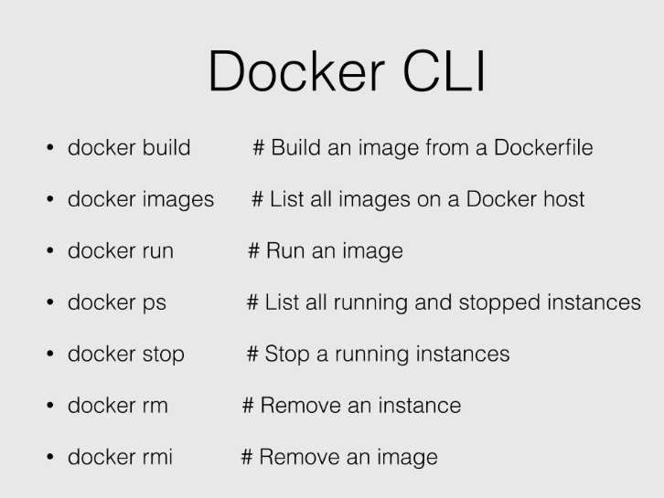

Slide 19
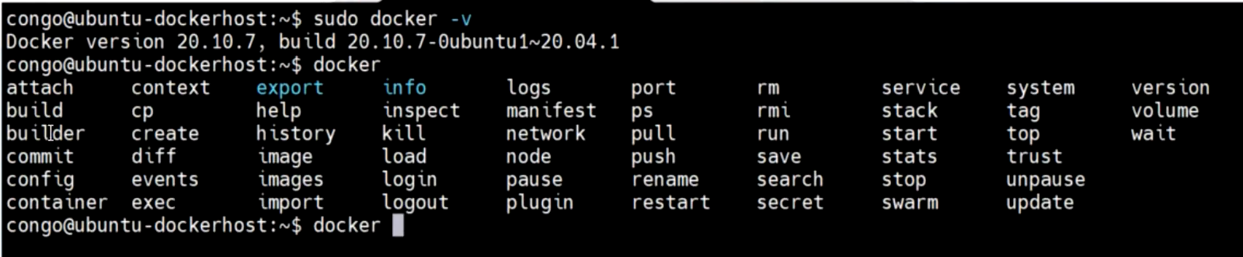
Docker Commands

Slide 20
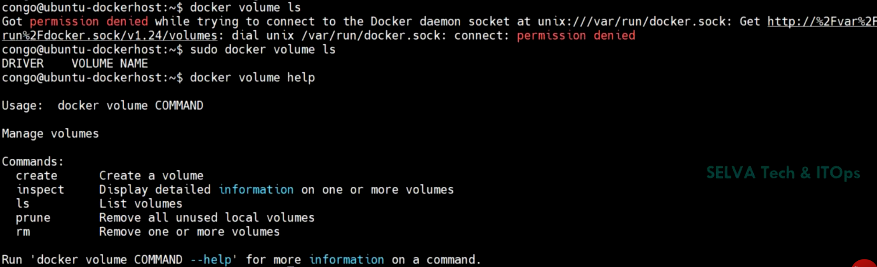

Slide 21
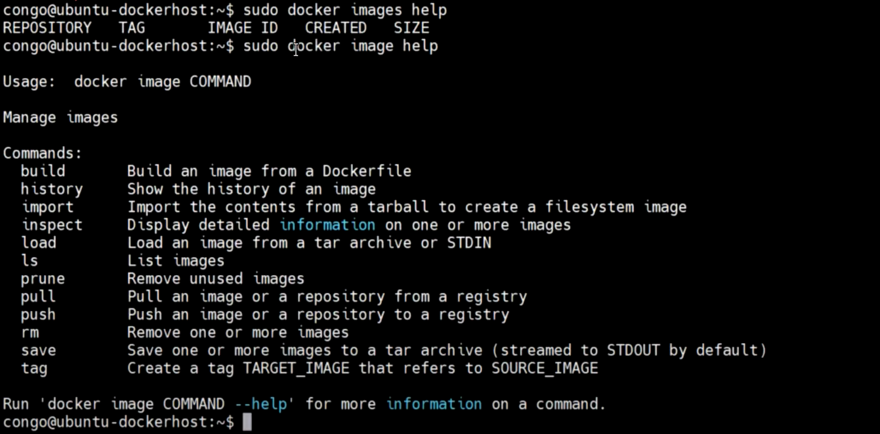

Slide 22
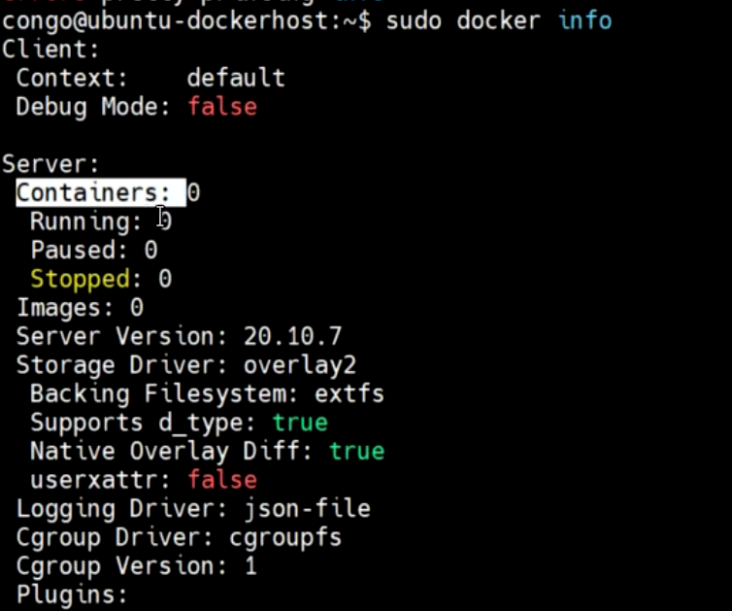

Slide 23
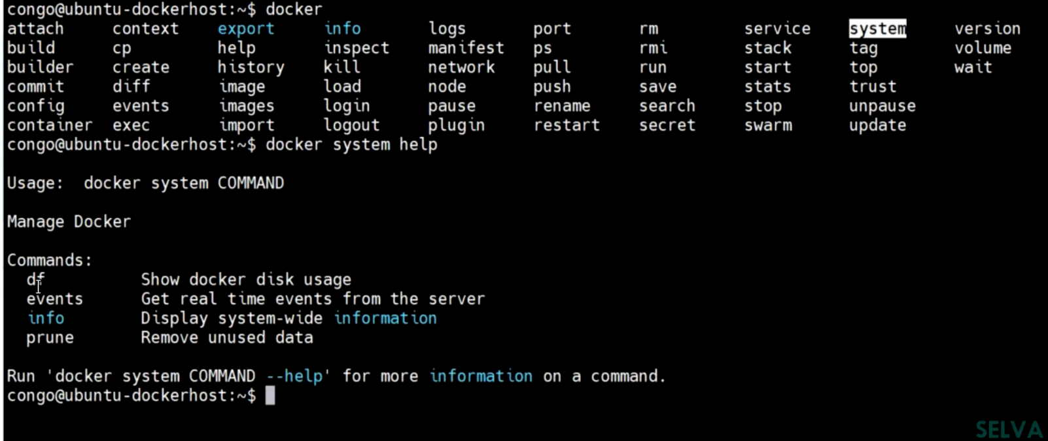

Slide 24
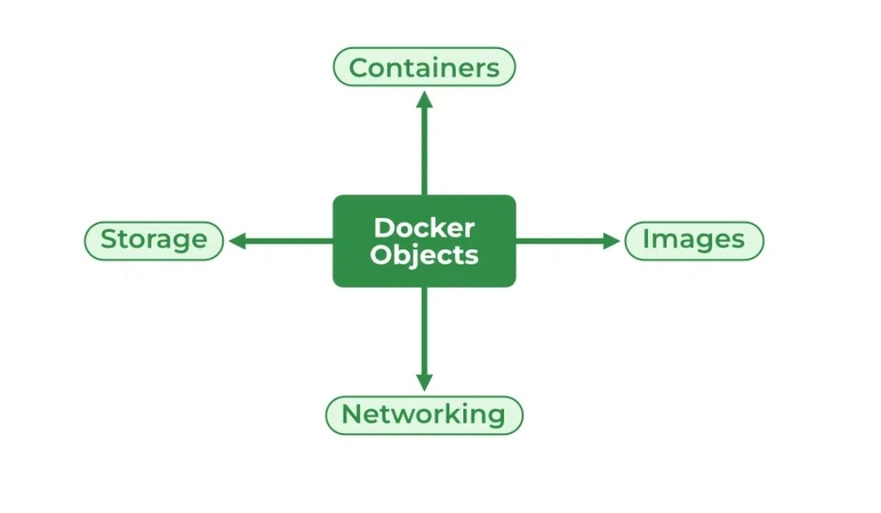
Docker Objects

Slide 25
Docker Images
An image contains instructions for creating a docker container.
read-only template.
used to store and ship applications.
Images are an important part of the docker experience as
they enable collaboration between developers in any way which is not possible earlier.

Slide 26
Docker Containers
Containers are created from docker images as they are ready applications.
With the help of Docker API or CLI, we can start, stop, delete, or move a container.
A container can access only those resources which are defined in the image unless additional access is defined during the building of an image in the container.

Slide 27
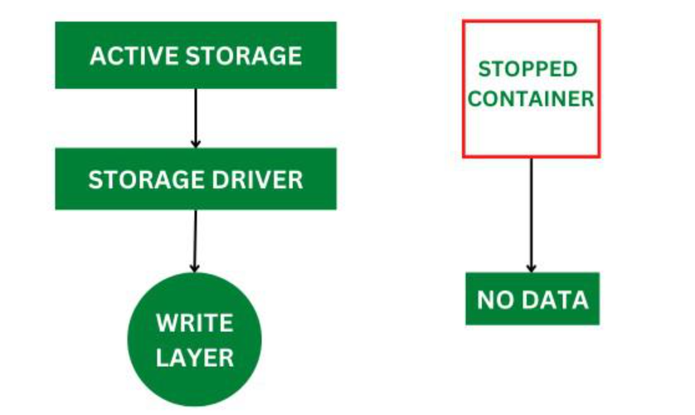
Docker Storage
We can store data within the writable layer of the container but it requires a storage driver. Storage driver controls and manages the images and containers on our docker host.

Slide 28
Types of Docker Storage
Data Volumes:
Data Volumes can be mounted directly into the filesystem of the container and are essentially directories or files on the Docker Host filesystem.
Volume Container:
In order to maintain the state of the containers (data) produced by the running container, Docker volumes file systems are mounted on Docker containers.
Independent container life cycle, the volumes are stored on the host. This makes it simple for users to exchange file systems among containers and backup data.

Slide 29
Types of Docker Storage
Directory Mounts:
A host directory that is mounted as a volume in your container might be specified.
Storage Plugins:
Docker volume plugins enable us to integrate the Docker containers with external volumes like Amazon EBS by this we can maintain the state of the container.

Slide 30
Docker Networking
Docker networking provides complete isolation for docker containers. It means a user can link a docker container to many networks. It requires very less OS instances to run the workload.

Slide 31
Types of Docker Network
Bridge:
It is the default network driver. We can use this when different containers communicate with the same docker host.
Host:
When you don’t need any isolation between the container and host then it is used.

Slide 32
Types of Docker Network
Overlay:
For communication with each other, it will enable the swarm services.
None:
It disables all networking.
macvlan:
This network assigns MAC(Media Access control) address to the containers which look like a physical address.

Slide 33
THANK YOU

